Slide 1
Project_2
Statistical Modelling Project
Simon Johnston
5-Dec-2022

Slide 2
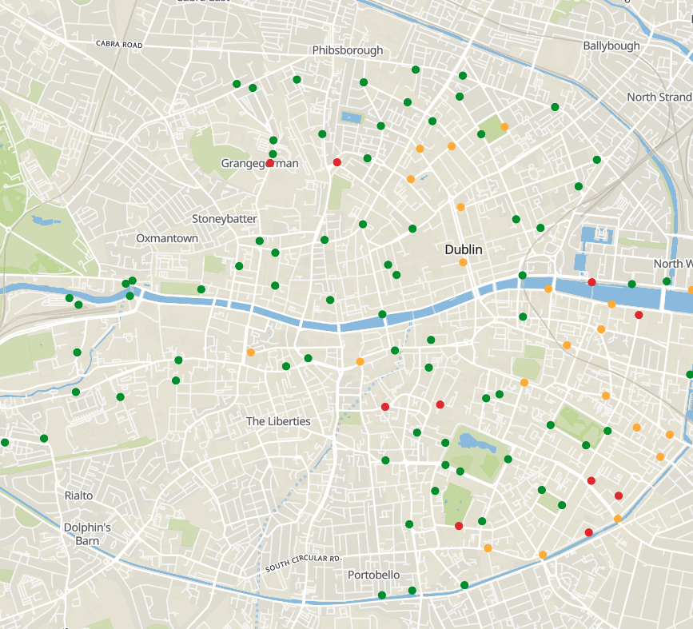
Introduction
Purpose:
Examine the relationship between bike-share stations and the points on interest in the surrounding area
Data Sources:
citybik.es
Provides bike-share data from over 400 cities around the world
FourSquare
Provides place recommendations based on geolocation
Yelp
Provide cloud sourced review data based on geolocation
Target Area:
Dublin, Ireland

Slide 3
Method
Initial EDA
Test API connection
Sample analysis
Field identification
Scaling
Scale to all bike stations
Join & Summarize
Join summaries from each API
Analysis & Model Creation
Establish relationships
Create and evaluate models

Slide 4
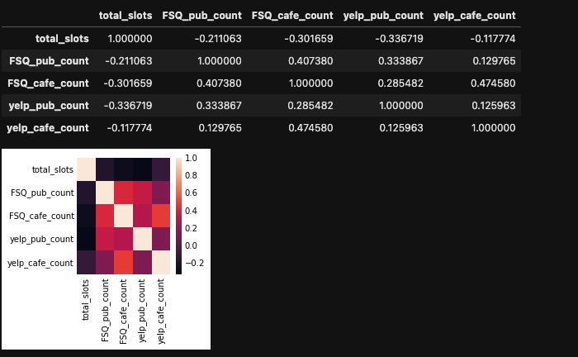
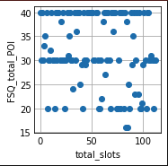
Results

Slide 5
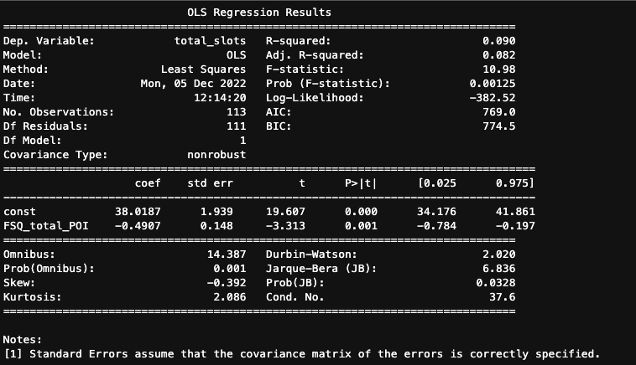
Results

Slide 6
Challenges
Response Limit:
Limit of 50 results in an incomplete sample of surrounding POIs creating inaccuracies in the dataset
Radius
Dublin is a small city, 1000m radius is the city centre
Time
Never enough of it

